Slide 1
RAZLOMCI

Slide 2
=1=10/10
4/10
6/10
Notes:
=4/10

Slide 3
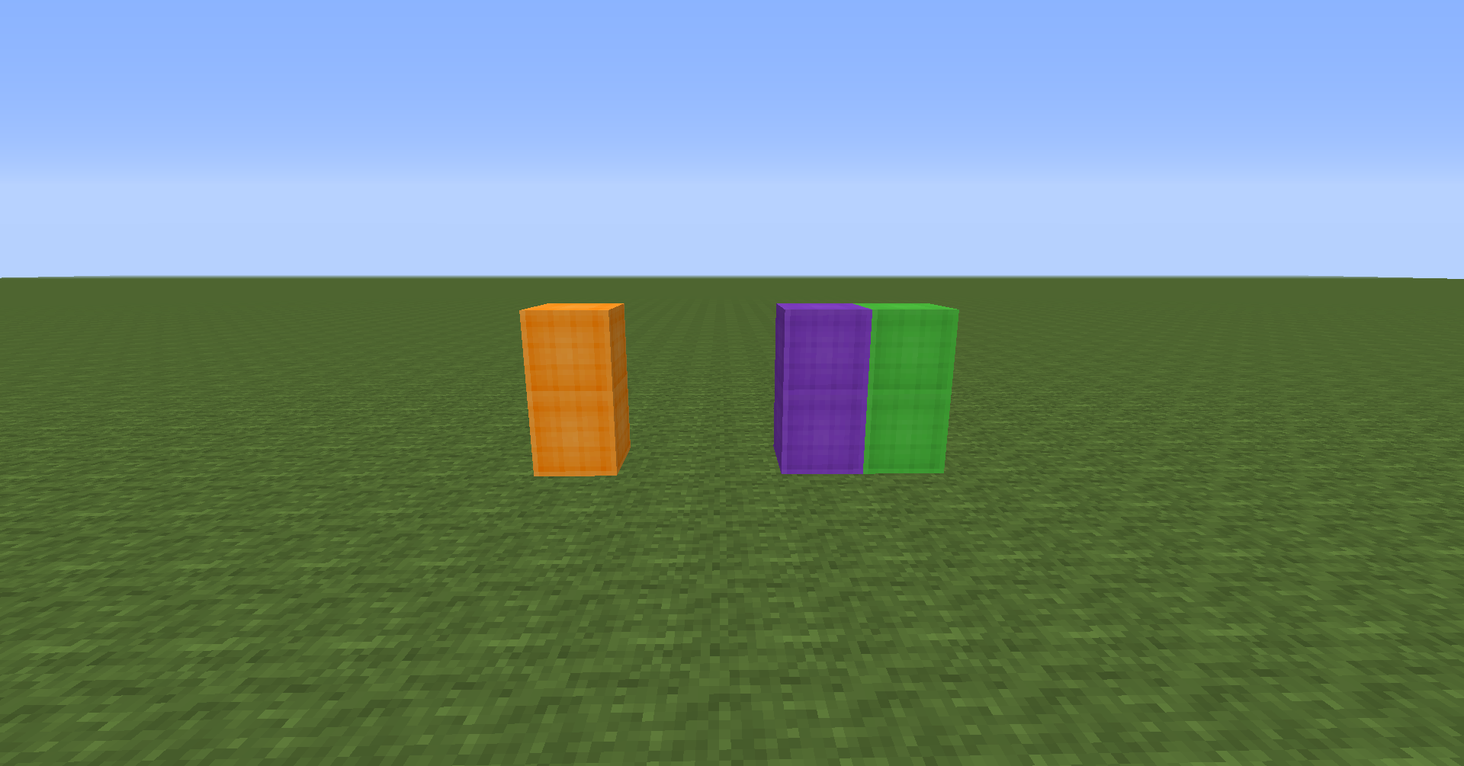
=1=3/3
1/3
2/3
Notes:
2/3

Slide 4
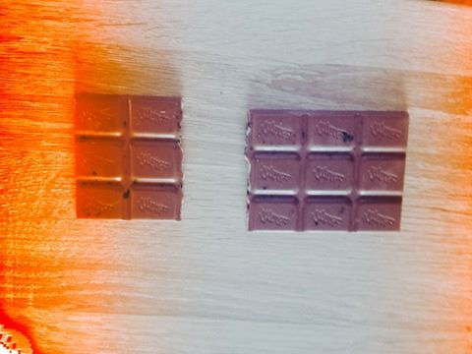
=1=15/15
6/15
9/15
Notes:
6/15

Slide 5
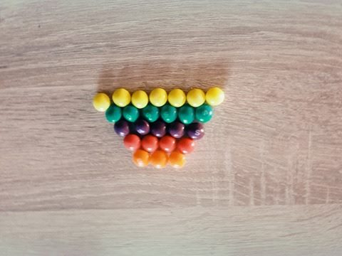
=1=25/25
7/25
6/25
5/25
4/25
3/25
Notes:
3/25

Slide 6
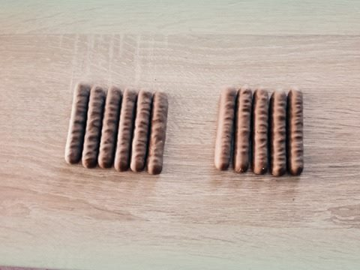
=1=11/11
6/11
5/11
Notes:
6/11

Slide 7
The end

